Slide 1

Mobile App
Our Team:
Suman Devkota
Navina Budhathoki
Arpan Pokhrel

Slide 2
KinMel
KinMel, the best place to shop online without any hassles.
At KinMel, prioritizing security: email and payment verification ensure a safe shopping environment.
Utilizing performance optimization strategies for lightning-fast page loads, ensuring a seamless shopping journey.

Slide 3
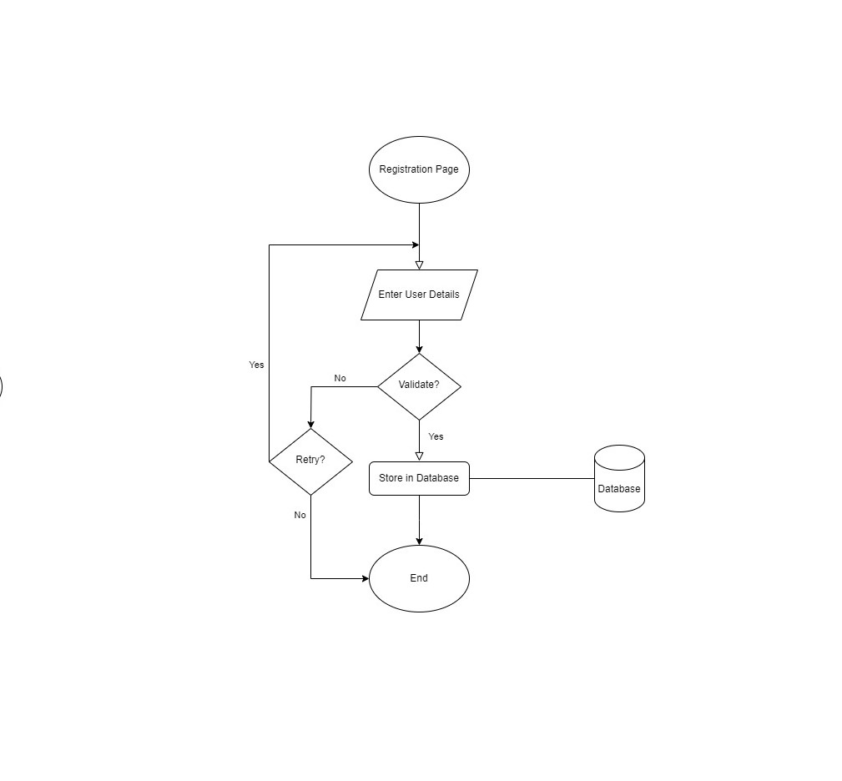
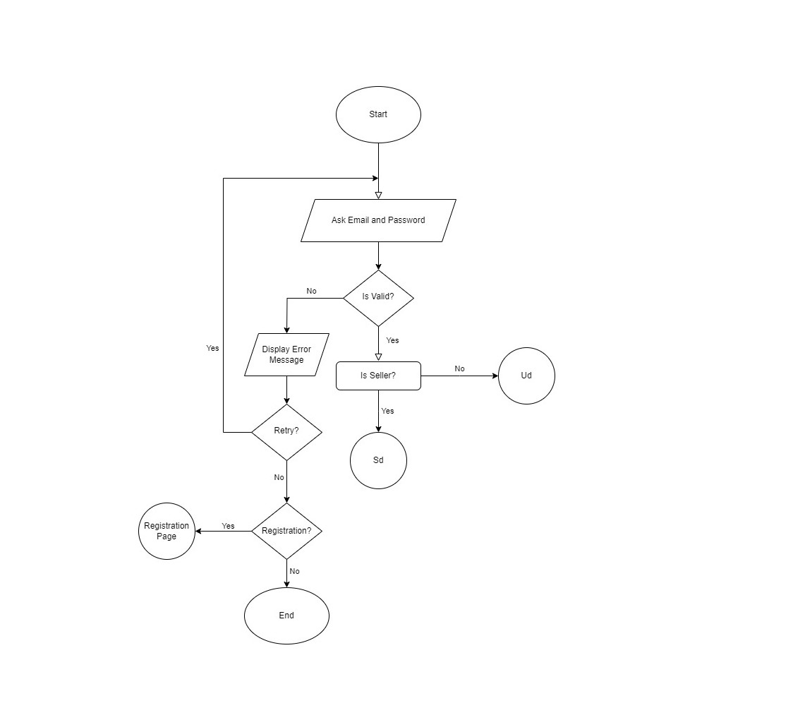
Flowchart
Flowchart
Flowchart

Slide 4
Fig: Flowchart (Registration)

Slide 5
Fig: Flowchart (Login)

Slide 6
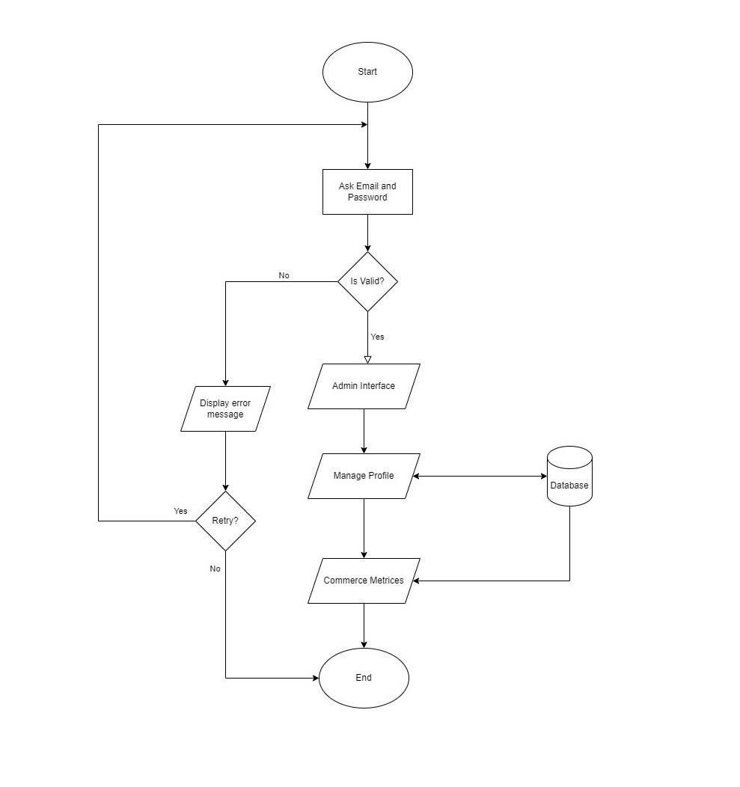
Fig: Flowchart (Admin)

Slide 7
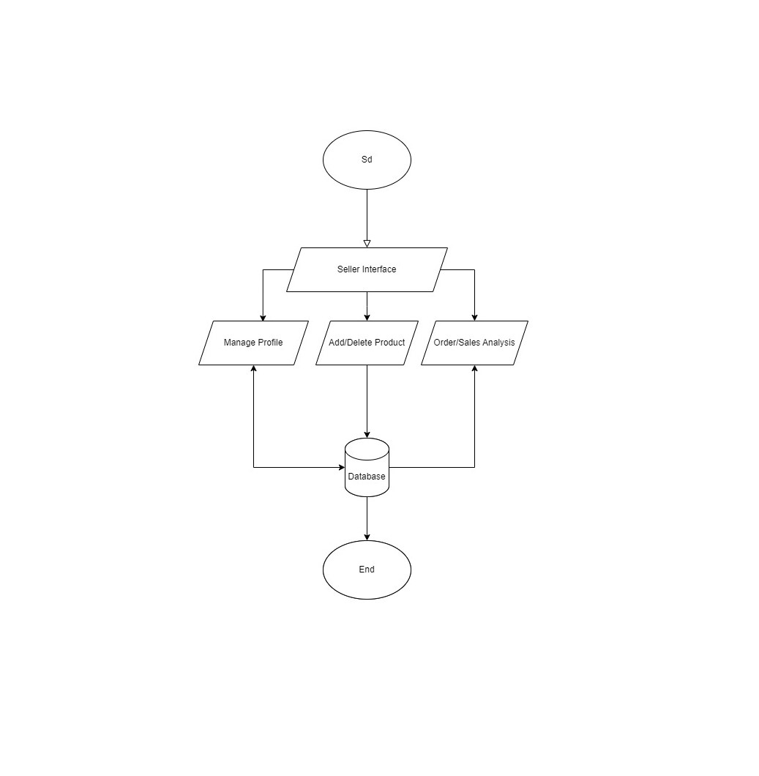
Fig: Flowchart (Seller)

Slide 8
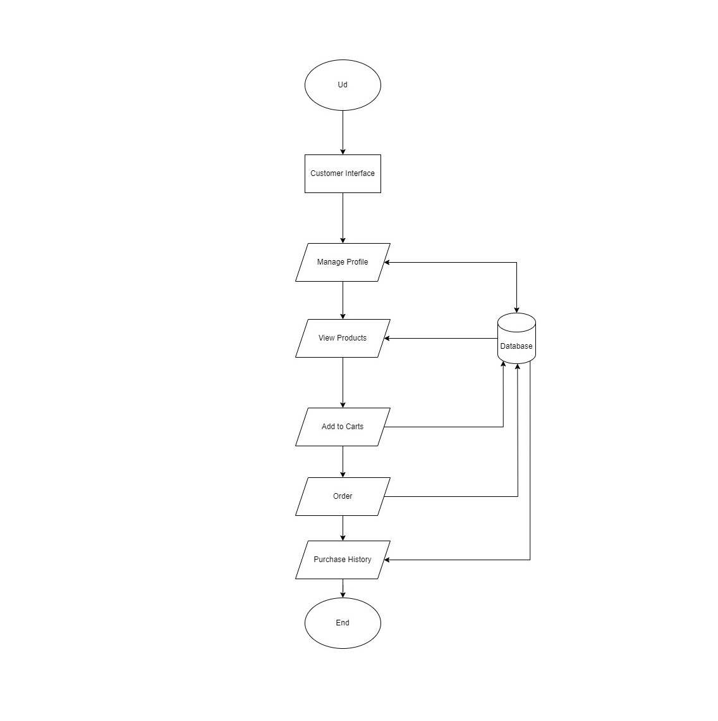
Fig: Flowchart (Buyer)

Slide 9
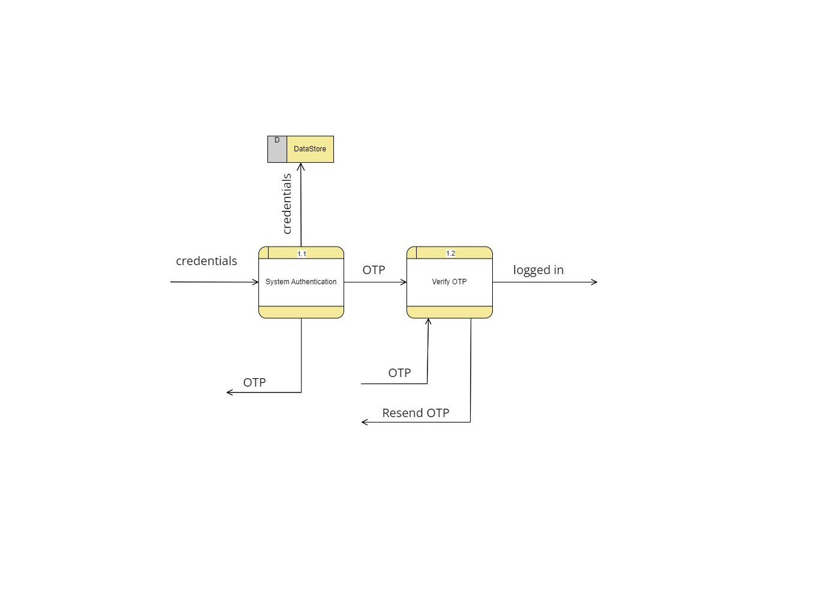
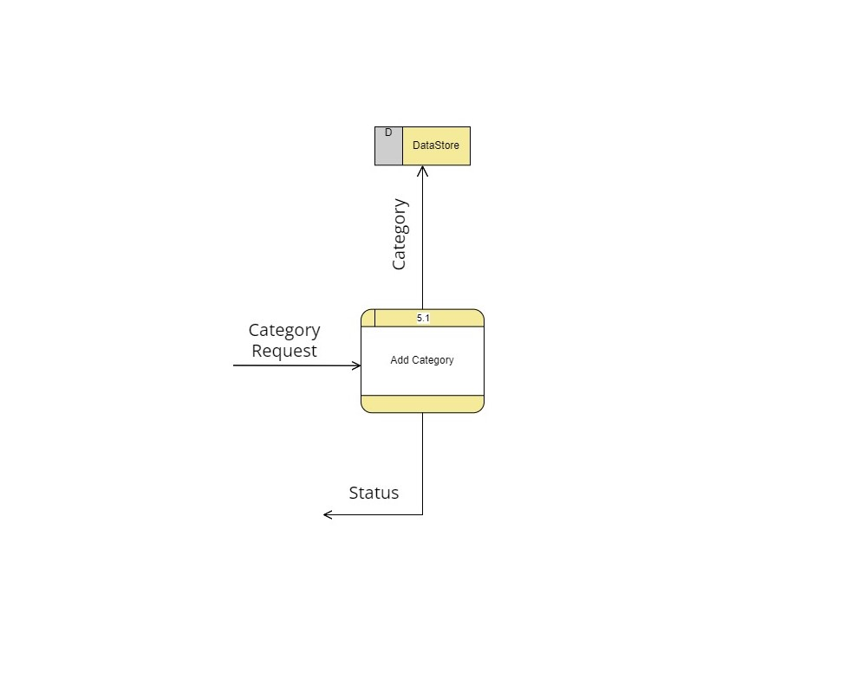
Data Flow Diagram
DFD-1
DFD-0

Slide 10
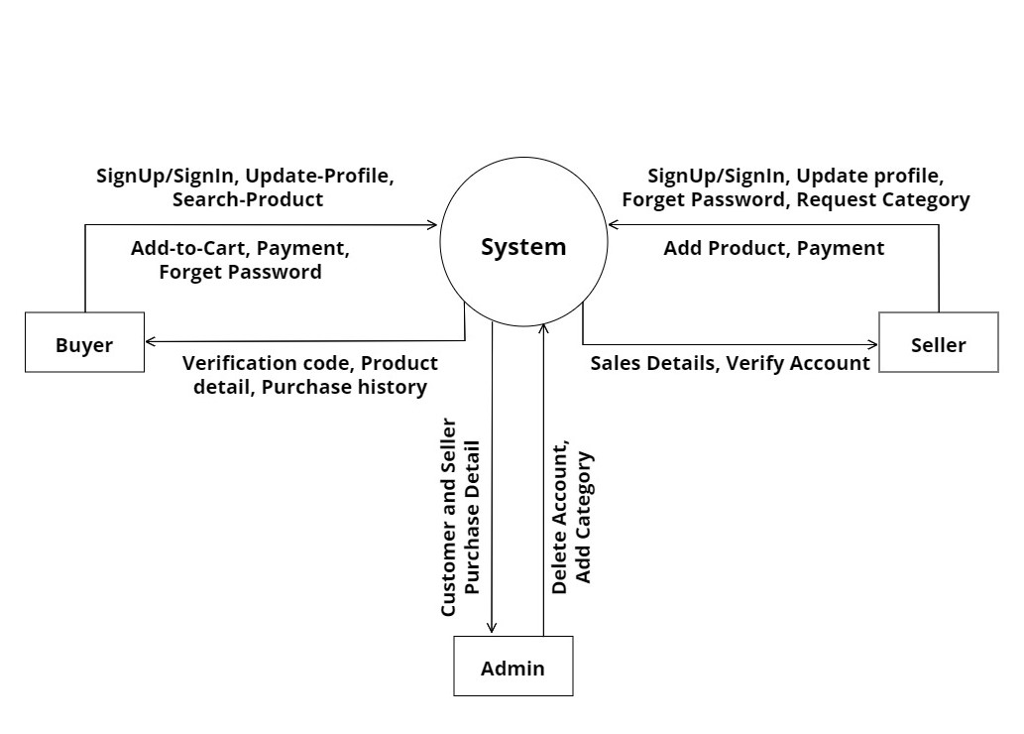
Fig: DFD Level-0

Slide 11
Fig: DFD Level-1(Authentication)

Slide 12
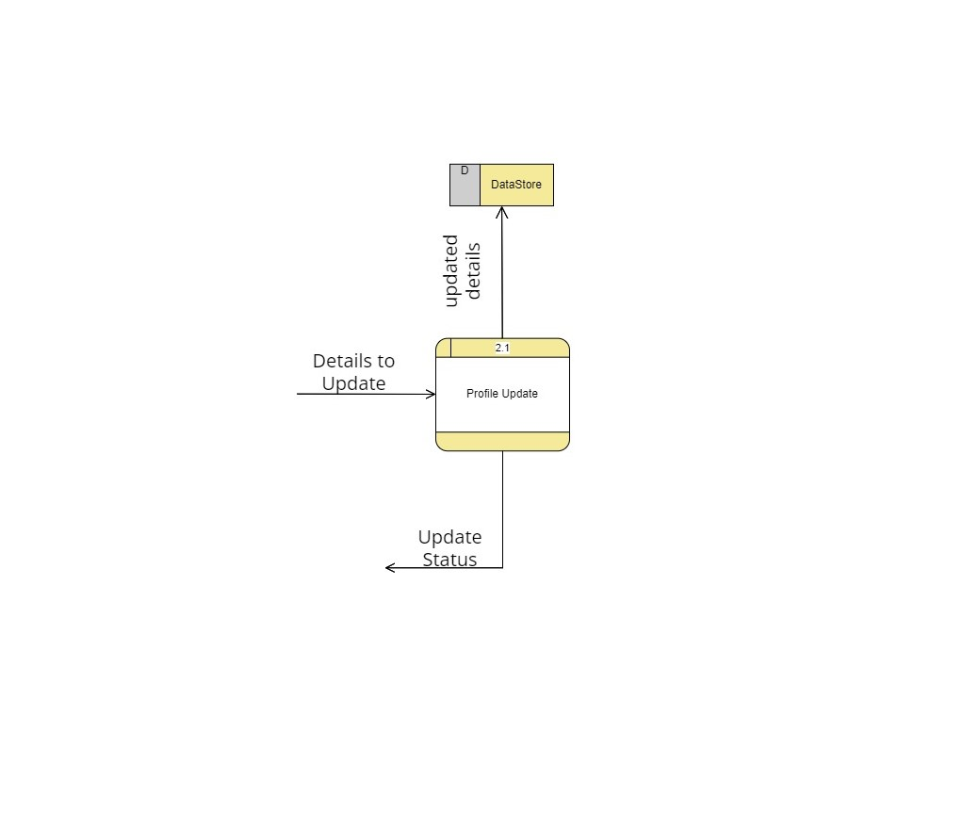
Fig: DFD Level-1(Manage Profile)

Slide 13
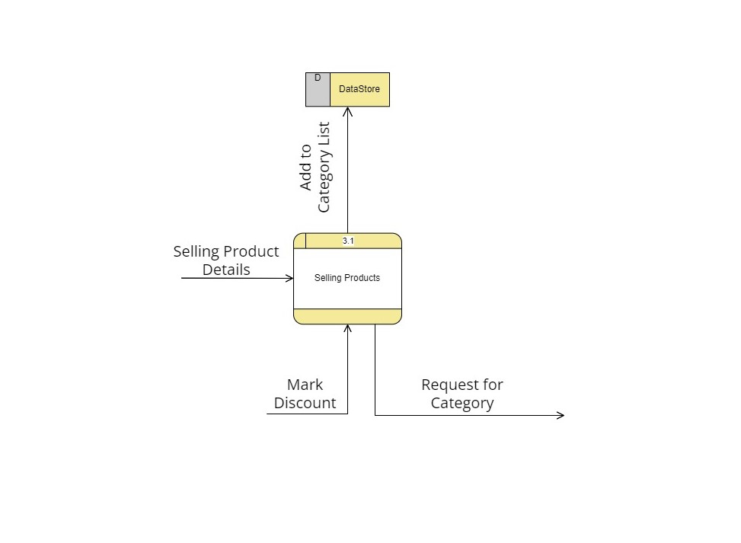
Fig: DFD Level-1(Add Products)

Slide 14
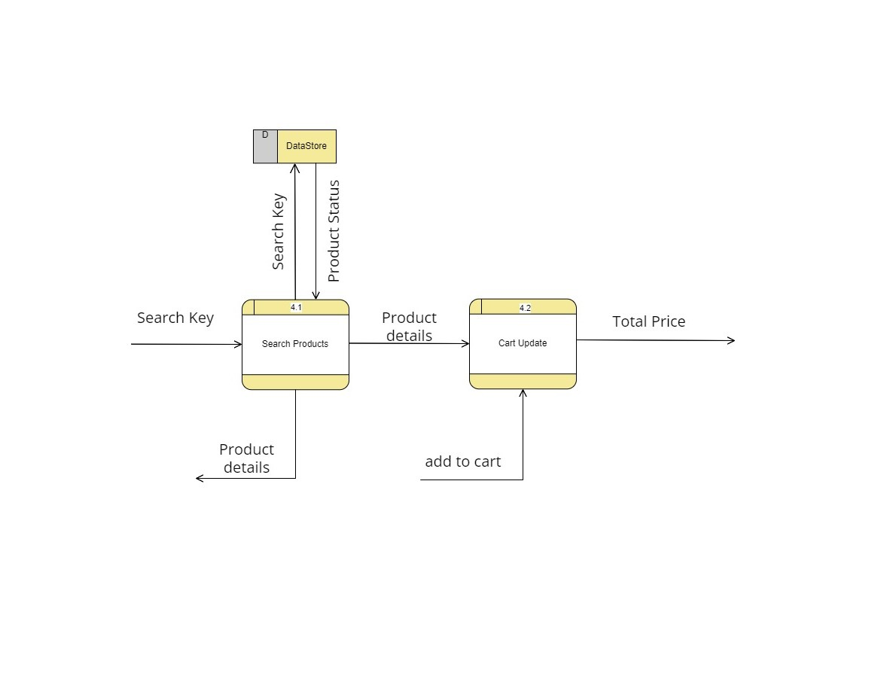
Fig: DFD Level-1(Add to Cart)

Slide 15
Fig: DFD Level-1(Request Category)

Slide 16
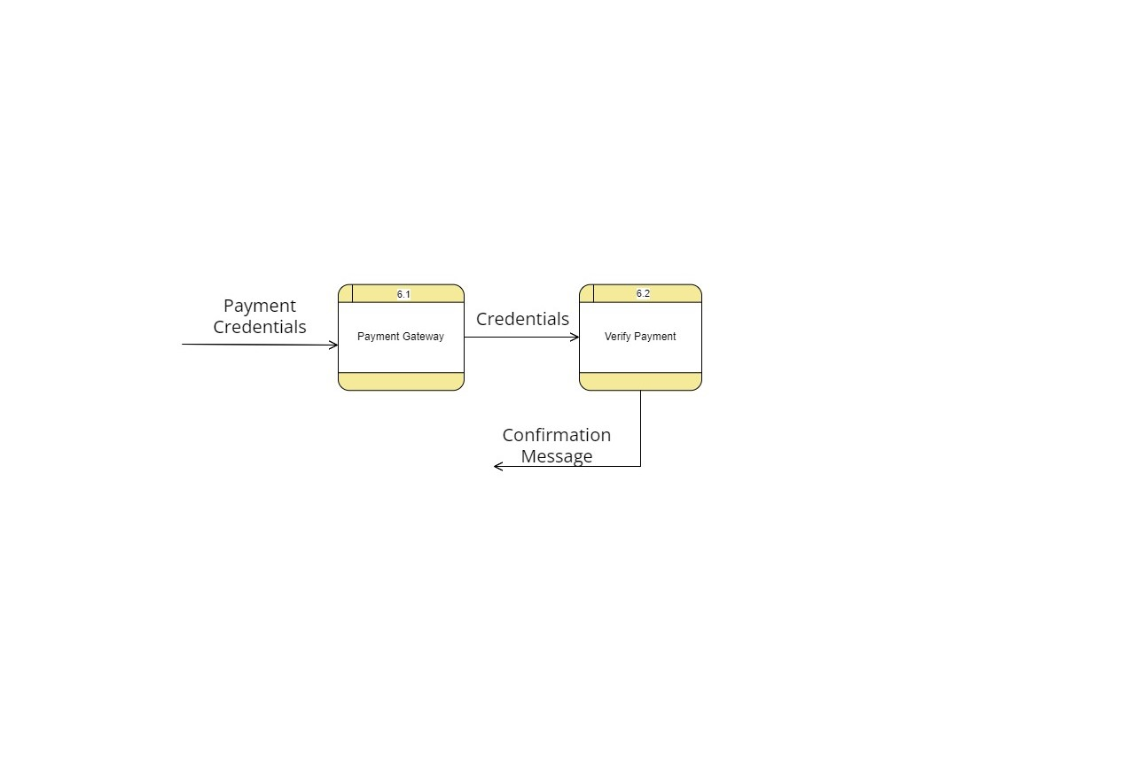
Fig: DFD Level-1(Payment)

Slide 17
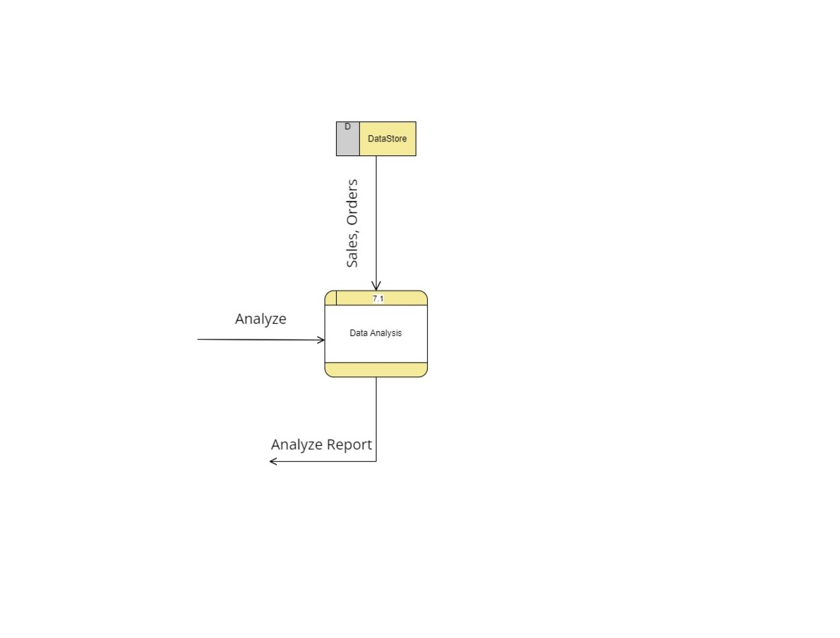
Fig: DFD Level-1(Analysis)

Slide 18
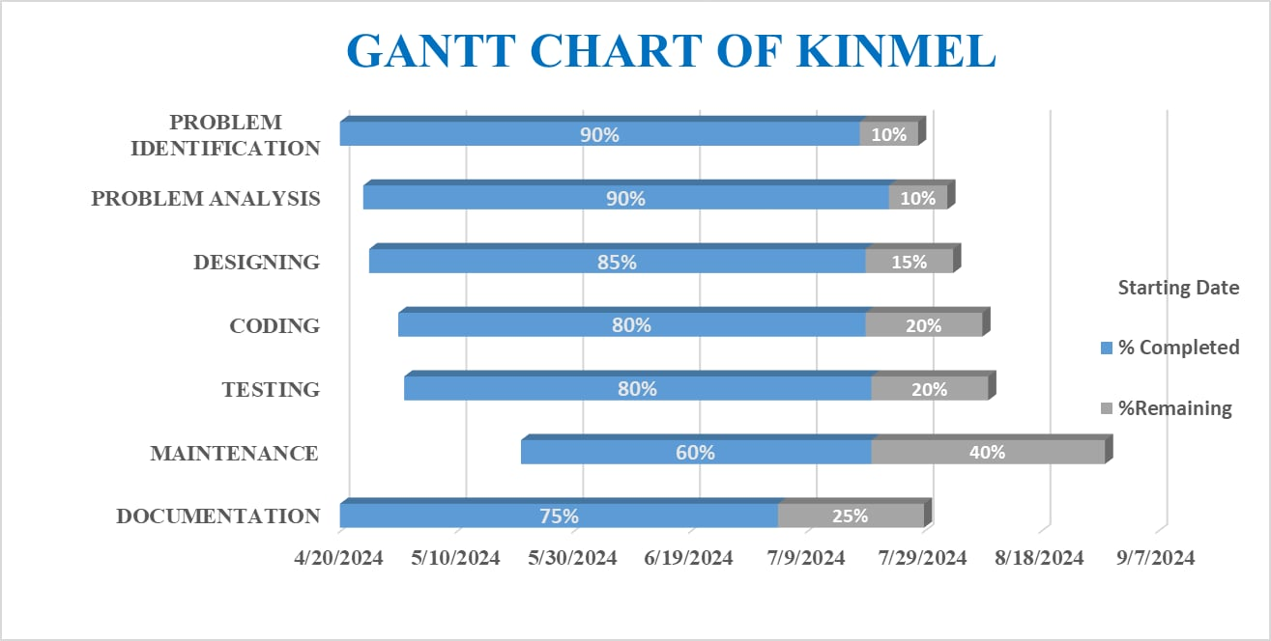
Fig: GANTT CHART

Slide 19
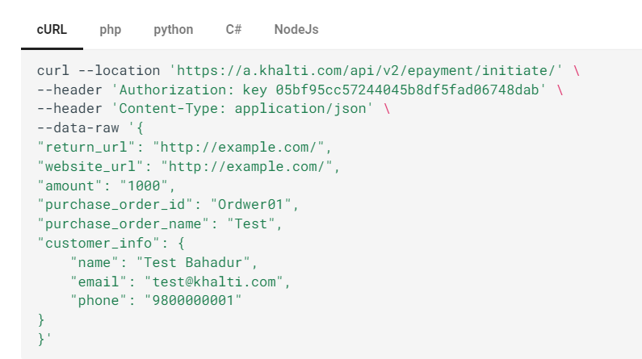
Fig:Bottleneck

Slide 20
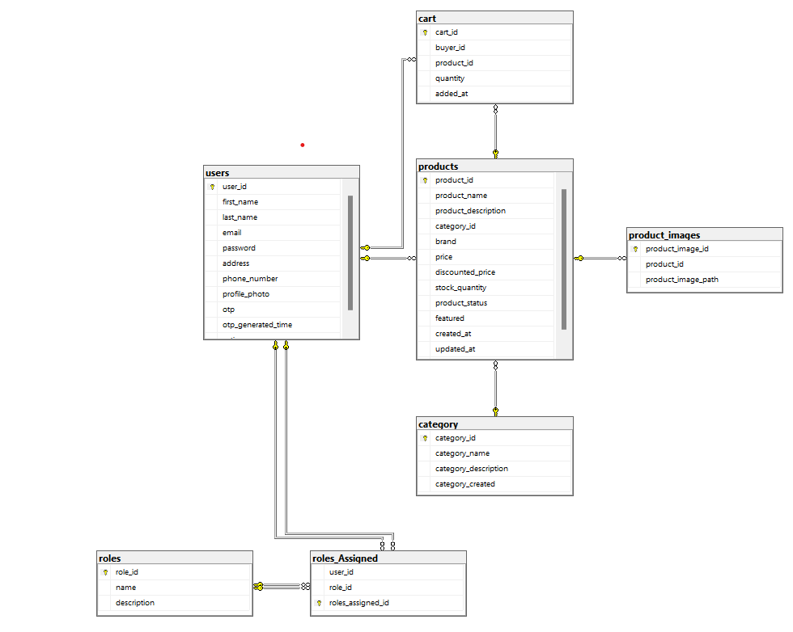
Fig: Database Schema

Slide 21
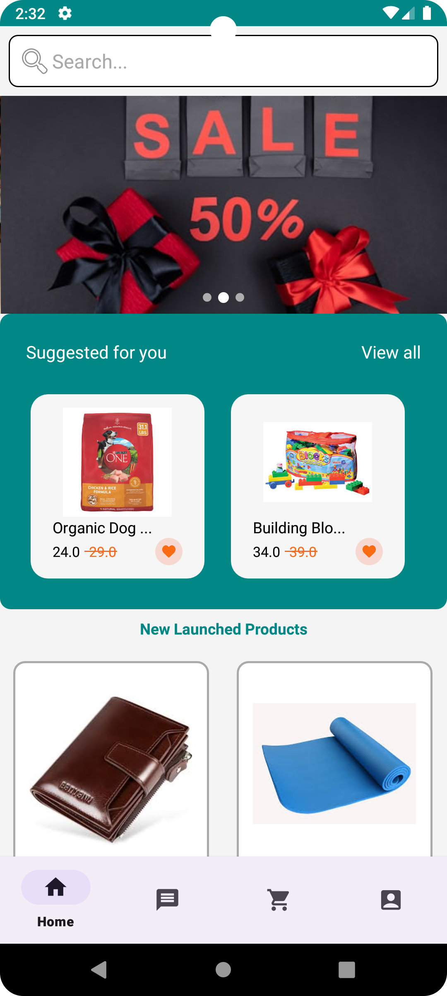
Demo
Demo

Slide 22
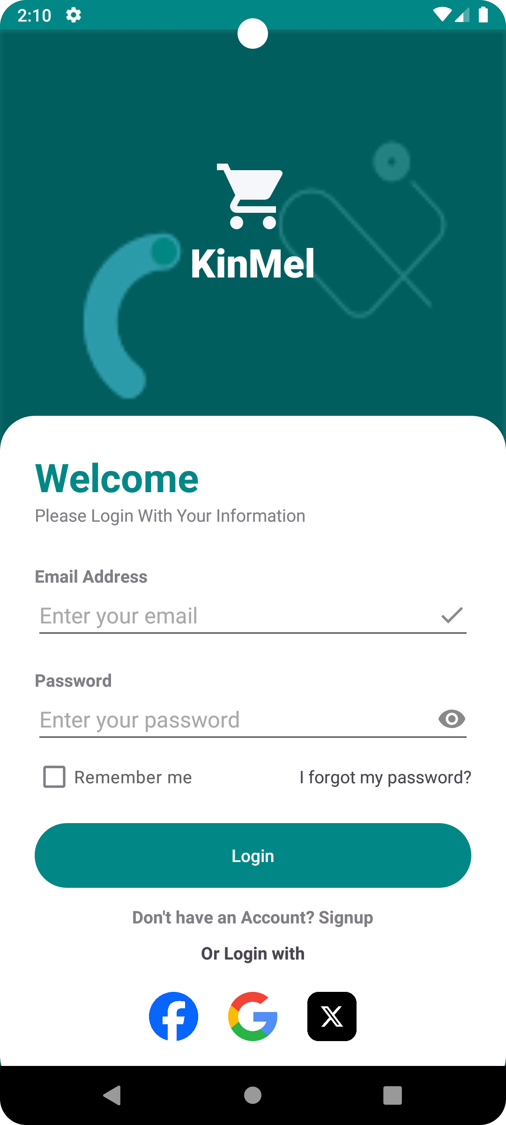
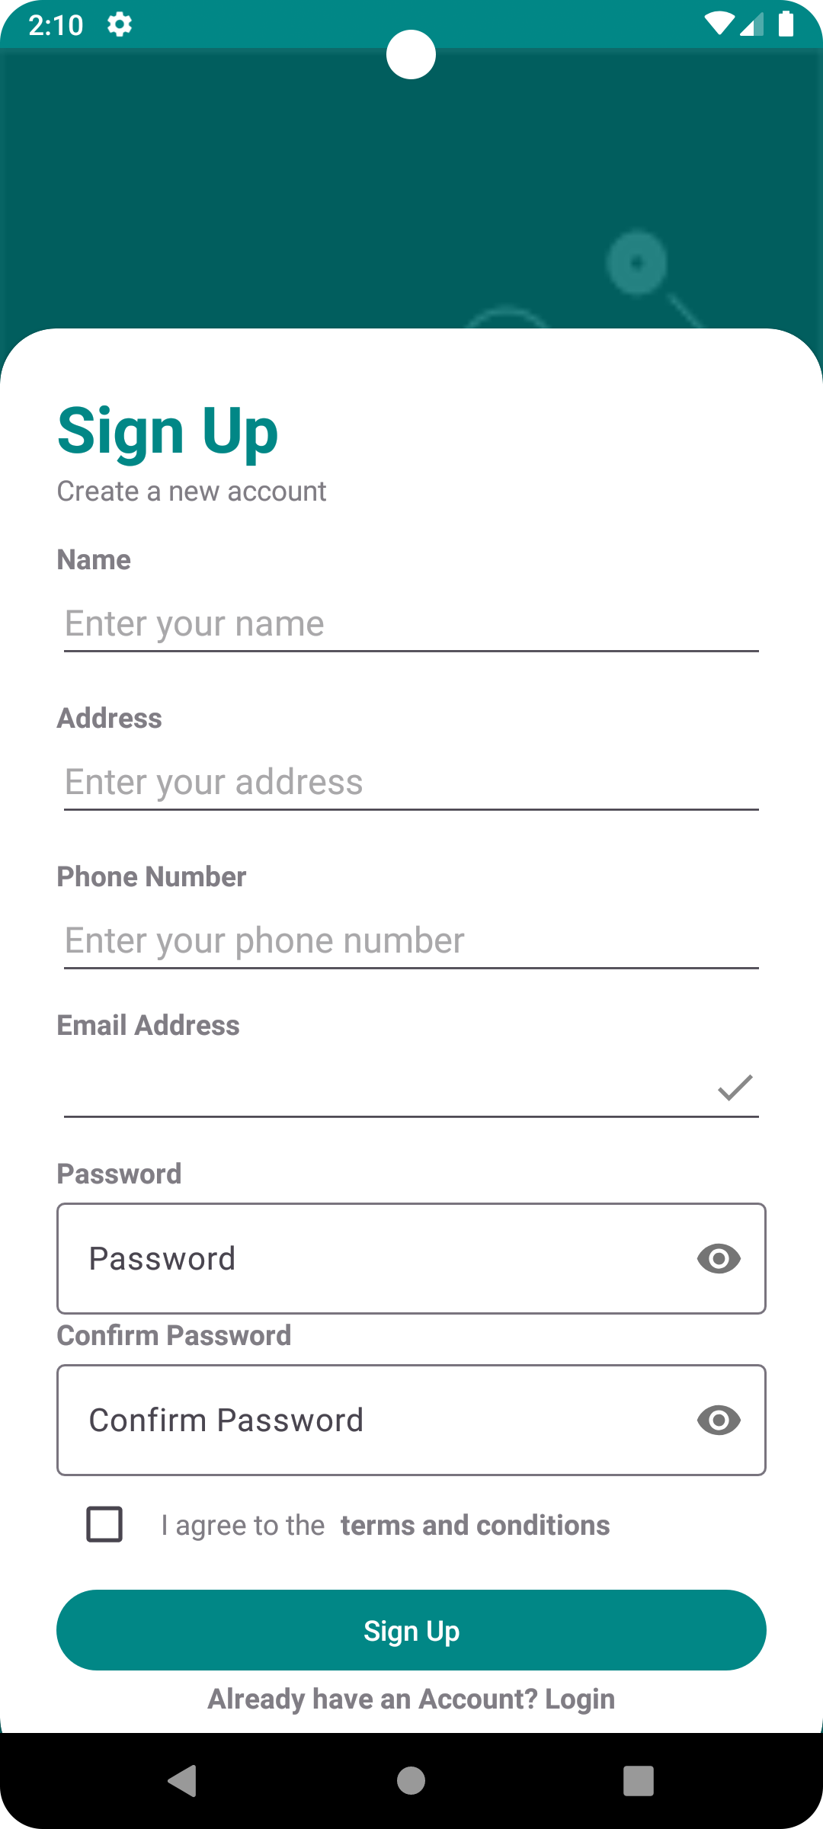
Login
Signup

Slide 23
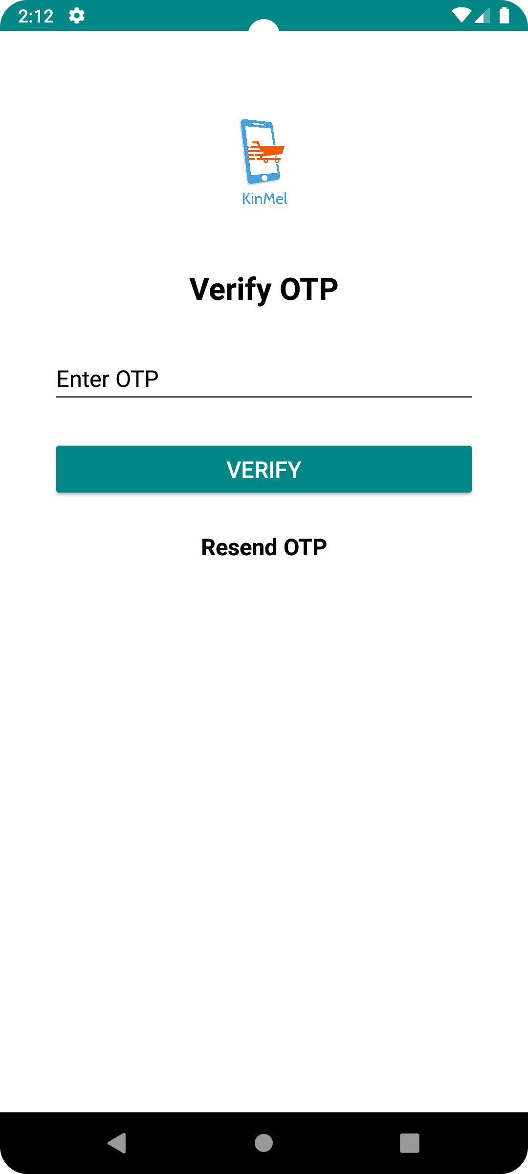
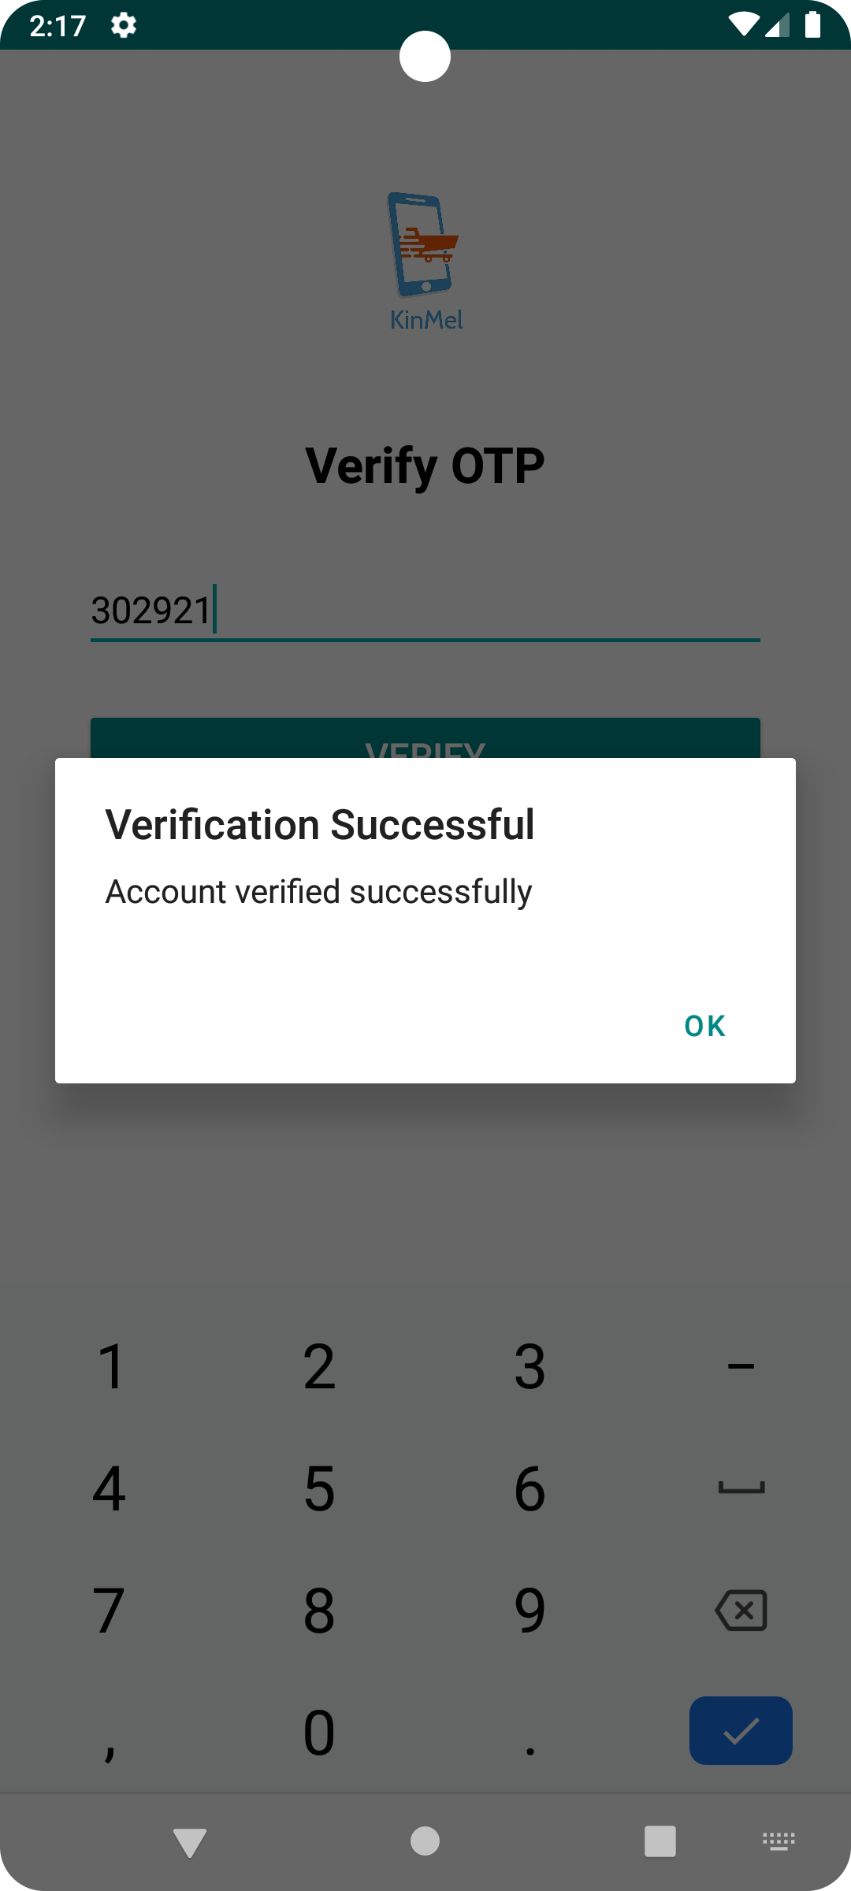
Verify with OTP
Verified

Slide 24
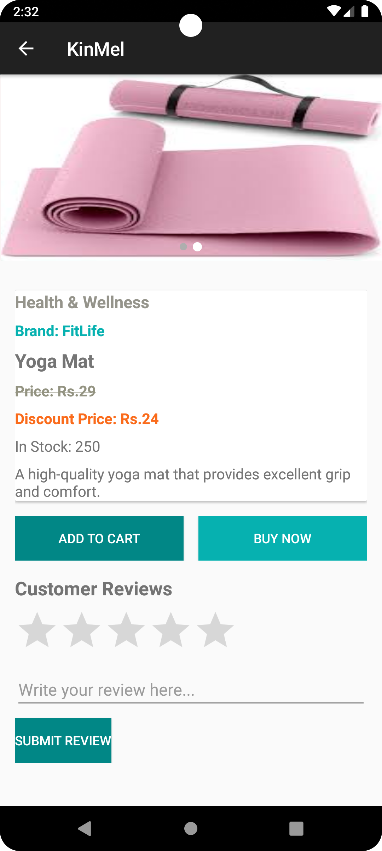
Home Page
Product Page

Slide 25
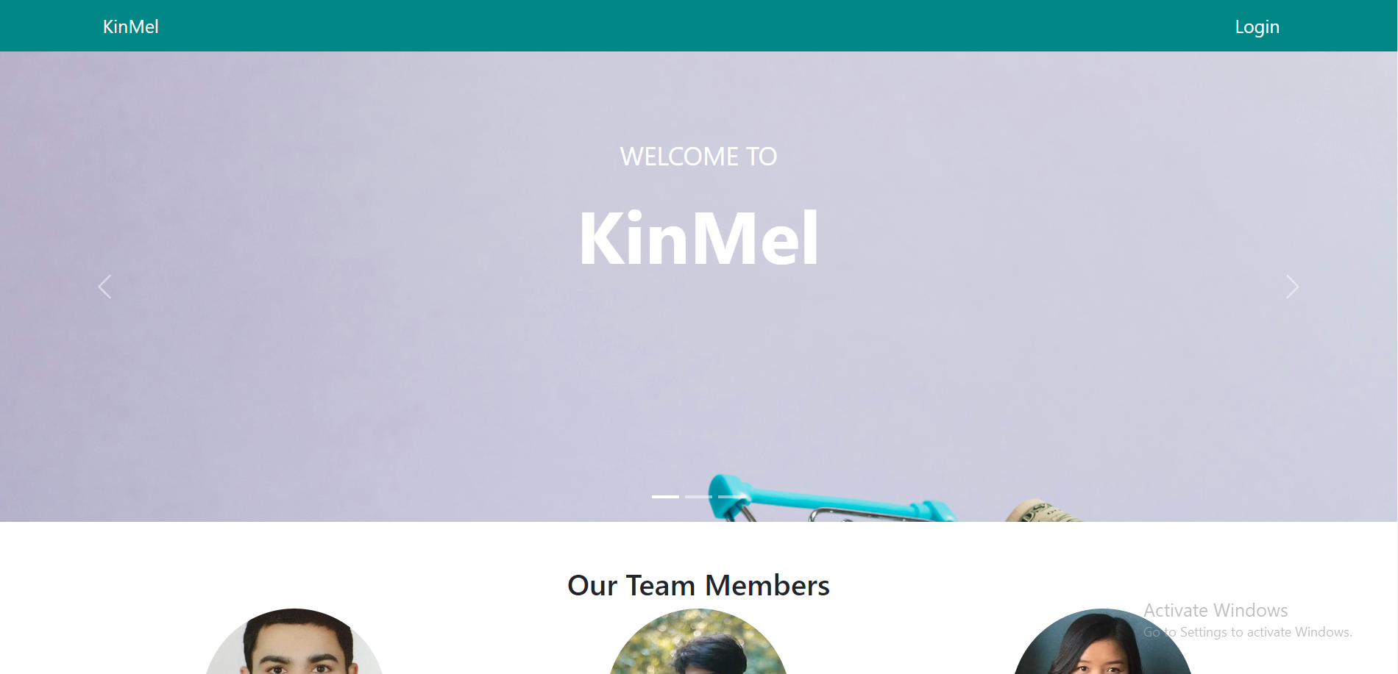
HomePage

Slide 26
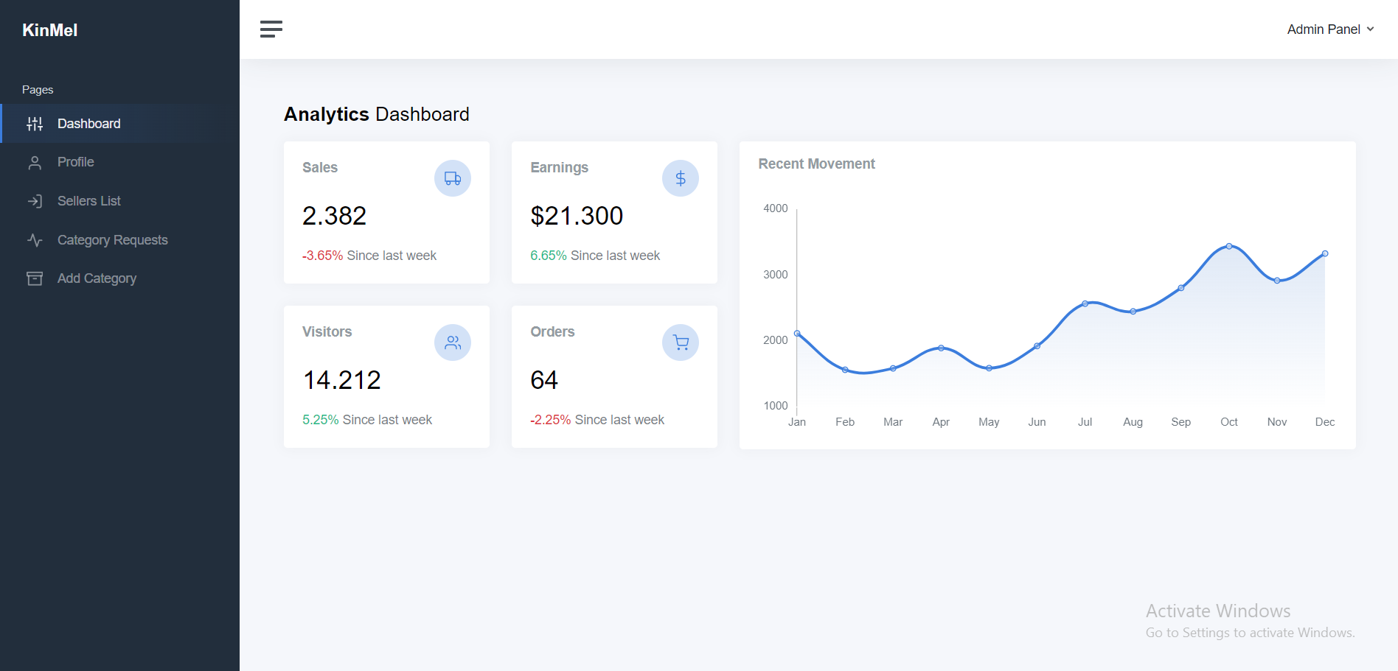
Dashboard

Slide 27


Slide 28
Thank You!
From KinMel Team

